Slide 1
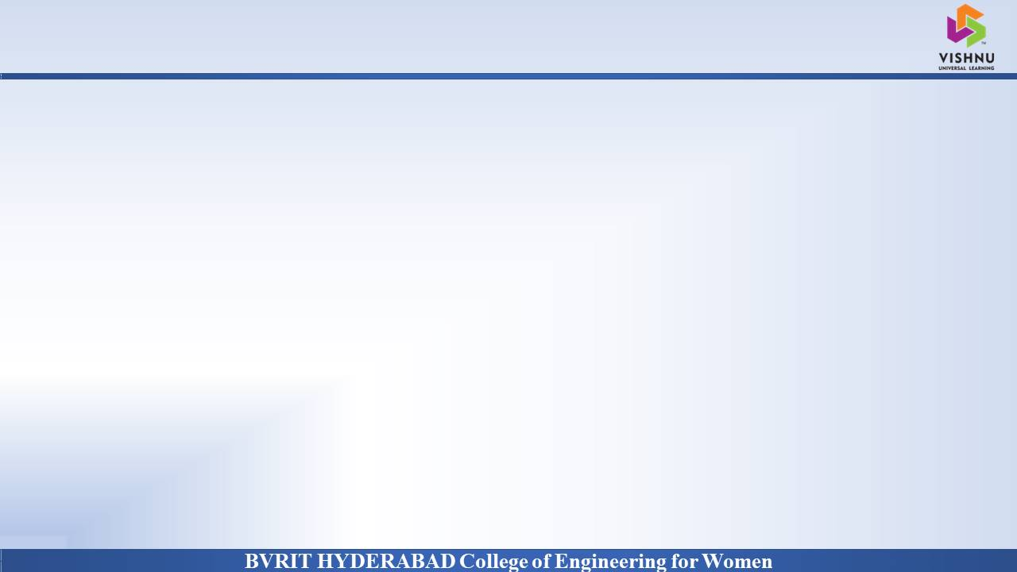
Department of Computer Science and Engineering
SCHOOL MANAGEMENT SYSTEM
Date: 19 April 2021
K. Siri Satwika : 17WH1A05B3
A. Sri Nithya : 17WH1A0578
S. Saharsha : 17WH1A0572
Internal Guide : Ms. Suparna Das
Designation : Assistant Professor

Slide 2

Abstract
Why Should I Study this course?
Education plays a great role in the development of any country. Many education organizations try to increase education quality. One of the aspects of this improvement is managing school resources.
This project contains the admin, teacher, parent and student side.Admin can manage students, Fees, teachers, classes, subjects, academic calendars and many more.Teachers role is to mark attendance, upload the marks, worksheets, teaching content, class recordings and give feedback to students. Student role is to view their marks, attendance, view teaching content, academic calendar, and write blogs and many more. Parent role is to view their child performance, give feedback about the school, and view the child fee structure.
Examples
BVRIT HYDERABAD College of Engineering for Women

Slide 3
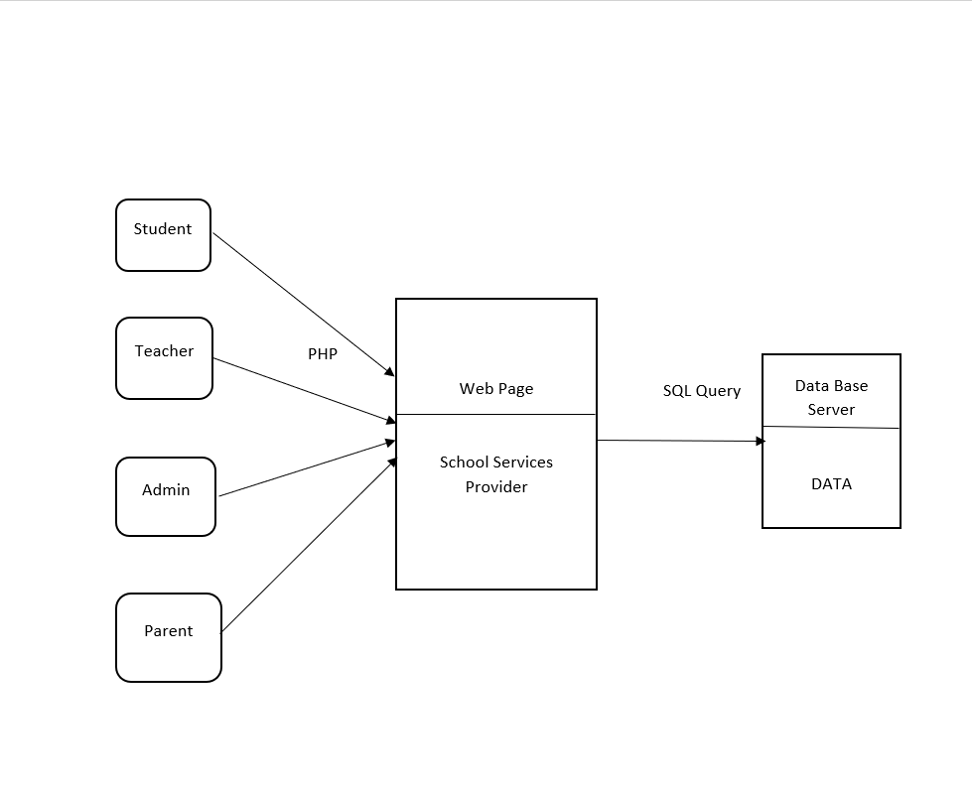
Architecture Diagram
Why Should I Study this course?
Examples
BVRIT HYDERABAD College of Engineering for Women

Slide 4
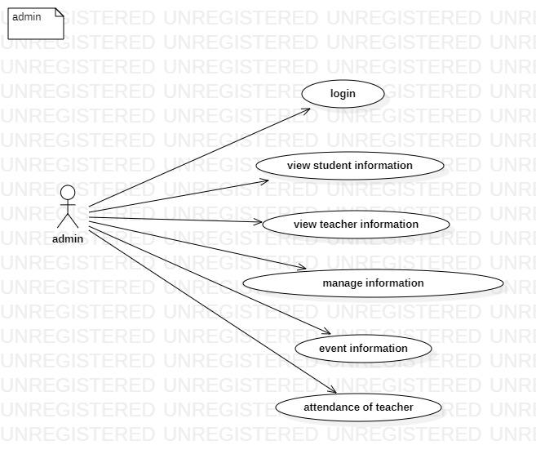
Usecase Diagram of Admin
Why Should I Study this course?
Examples
BVRIT HYDERABAD College of Engineering for Women

Slide 5
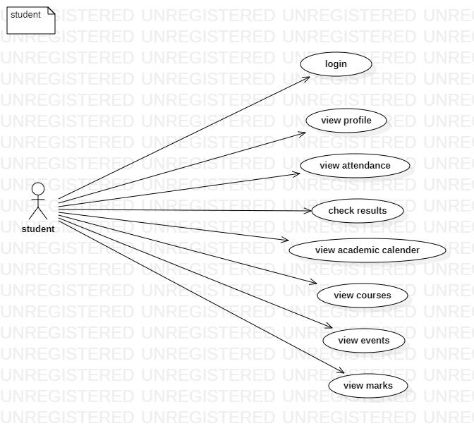
Usecase Diagram of Student
Why Should I Study this course?
Examples
BVRIT HYDERABAD College of Engineering for Women

Slide 6
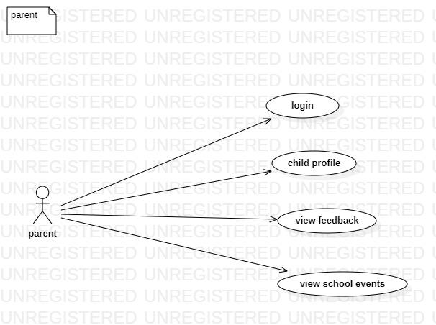
Usecase Diagram of Parent
Why Should I Study this course?
Examples
BVRIT HYDERABAD College of Engineering for Women

Slide 7
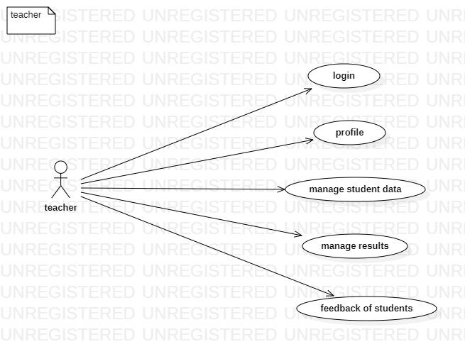
Usecase Diagram of Teacher
Why Should I Study this course?
Examples
BVRIT HYDERABAD College of Engineering for Women

Slide 8
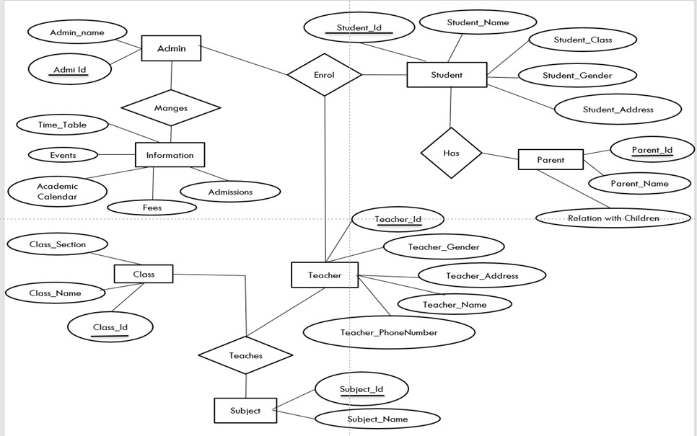
E-R Diagram
Why Should I Study this course?
Examples
BVRIT HYDERABAD College of Engineering for Women

Slide 9
Technology Stack
Why Should I Study this course?
HTML
PHP
CSS
Bootstrap
JavaScript
Examples
BVRIT HYDERABAD College of Engineering for Women

Slide 10
References
Why Should I Study this course?
[1] Er. Saurabh Walia, Er. Satinderjit Kaur Gill, “A Framework for Web Based Student Record Management System using PHP”, IJCSMC, Vol. 3, Issue. 8, August 2014.(base paper)
[2] S. R.Bharmagoudar, Geeta R.B and S.G. Totad, “Web based student management system.”, Andra Pradesh, vol.2 June 2013. (base paper)
[3] D. Zhibing Liu, Huixia Wang, Hui Zan “Design and implementation of student information management system.” 2010 International Symposium on intelligence information processing and trusted computing.
[4] M.A.Norasiah and A.Norhayti “Intelligent student information system.”, 4th International conference on telecommunication technology proceedings. Shah Alam, Malaysia, 0-7803-7773-7/03 2013 IEEE
[5] CAI Chang-an, WaNG Qi, “Design and implementation of student information management system based on B/S model”, computer engineering and design, Beijing, 2012.
Examples
BVRIT HYDERABAD College of Engineering for Women

Slide 11
Thankyou

